Slide 1

DeKalb Chinese School Jingwan Li

Slide 2


Slide 3


Slide 4


Slide 5


Slide 6


Slide 7
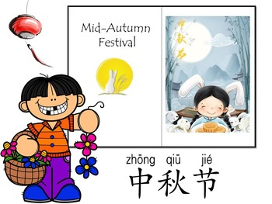
https://www.youtube.com/watch?v=Neu7YThsOx0

Slide 8
Lunar Calendar 8.15 农历 八月十五
[bā yuè shí wǔ]

Slide 9
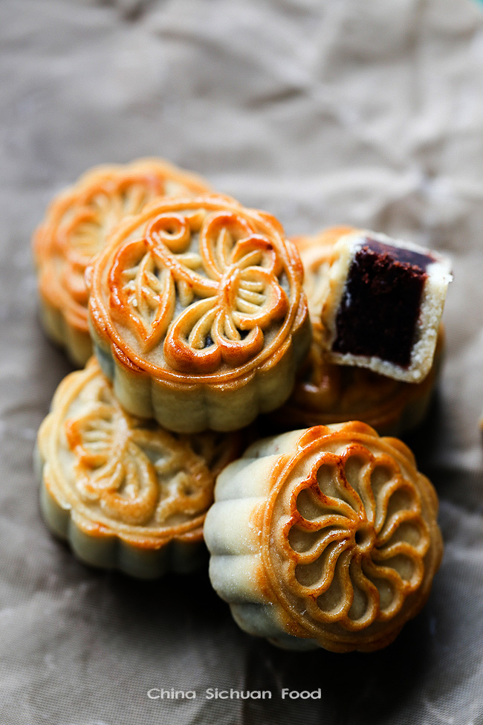
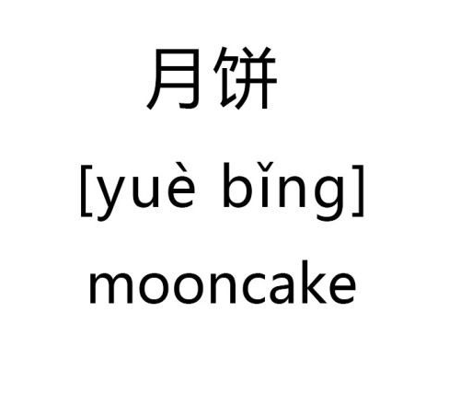

Slide 10
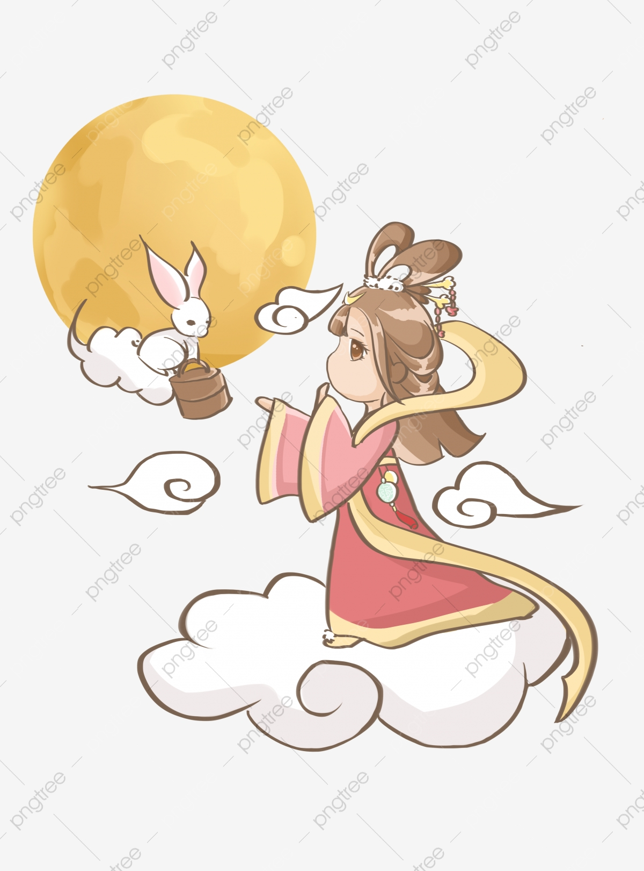
嫦娥 [cháng é ] goddess in the moon
玉兔
[yù tù]
Jude rabbit
rabbit in the moon

Slide 11


Slide 12


